Slide 1
BDD
Behavior-driven development

Slide 2
User Story
Как (As a) [X]
Я хочу (I want) [Y]
Чтобы (so that) [Z]

Slide 3
User story validation
Допустим (Given) некоторый начальный контекст (данность), Если (When) происходит событие, То (then) убедится, что получены некоторые результаты.

Slide 4
User story example
+Название: Клиент изымает наличные+
Как клиент, Я хочу получить наличные из банкомата, чтобы мне не пришлось стоять в очереди в банке.

Slide 5
Example
как мы узнаем, что реализовали эту историю?
Нужно рассмотреть несколько сценариев:
на счету есть деньги
счет может быть превышен, но не вышел за границы лимита
счет может быть превышен за рамки лимита.
Это счет по кредиту и текущее снятие приводит к превышению лимита
в банкомате недостаточно наличности
И т.д.

Slide 6
Scenario 1
+Scenario 1: Account is in credit+
Given the account is in credit And the card is valid And the dispenser contains cash When the customer requests cash Then ensure the account is debited And ensure cash is dispensed And ensure the card is returned

Slide 7
Scenario 2
+Scenario 2: Account is overdrawn past the overdraft limit+
Given the account is overdrawn And the card is valid When the customer requests cash Then ensure a rejection message is displayed And ensure cash is not dispensed And ensure the card is returned

Slide 8
A story is a collection of scenarios
Narrative:
In order to communicate effectively to the business some functionality
As a development team
I want to use Behaviour-Driven Development
Scenario: A scenario is a collection of executable steps of different type
Given step represents a precondition to an event
When step represents the occurrence of the event
Then step represents the outcome of the event
Scenario: Another scenario exploring different combination of events
Given a precondition
When a negative event occurs
Then a the outcome should be captured

Slide 9
Given, When and Then are also called BDD Keywords
A scenario can contain any number of steps, and steps of the same type can follow each other:
Given a wizard named Harry
Given a wizard named Hermione
When the wizards meet
Then a spark should occur
This scenario signals that there are two preconditions to the event of the wizards meeting. As such, it may be expressed in an equivalent way:
Given a wizard named Harry
And a wizard named Hermione
When the wizards meet
Then a spark should occur

Slide 10
Story – collection of scenarios
Narrative:
In order to develop an application that requires a stack efficiently
As a development team
I would like to use an interface and implementation in Java directly
Scenario: Basic functionality of a Stack
Given an empty stack
When the string Java is added
And the string C++ is added
And the last element is removed again
Then the resulting element should be Java

Slide 11
Story – collection of scenarios
Scenario: Stack search
Given an empty stack
When the string Java is added
And the string C++ is added
And the string PHP is added
And the element Java is searched for
Then the position returned should be 3

Slide 12
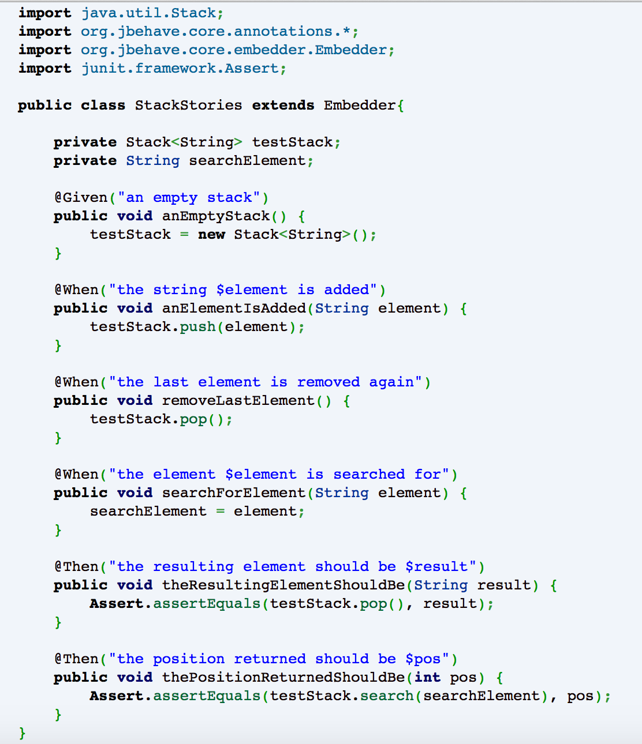

Slide 13
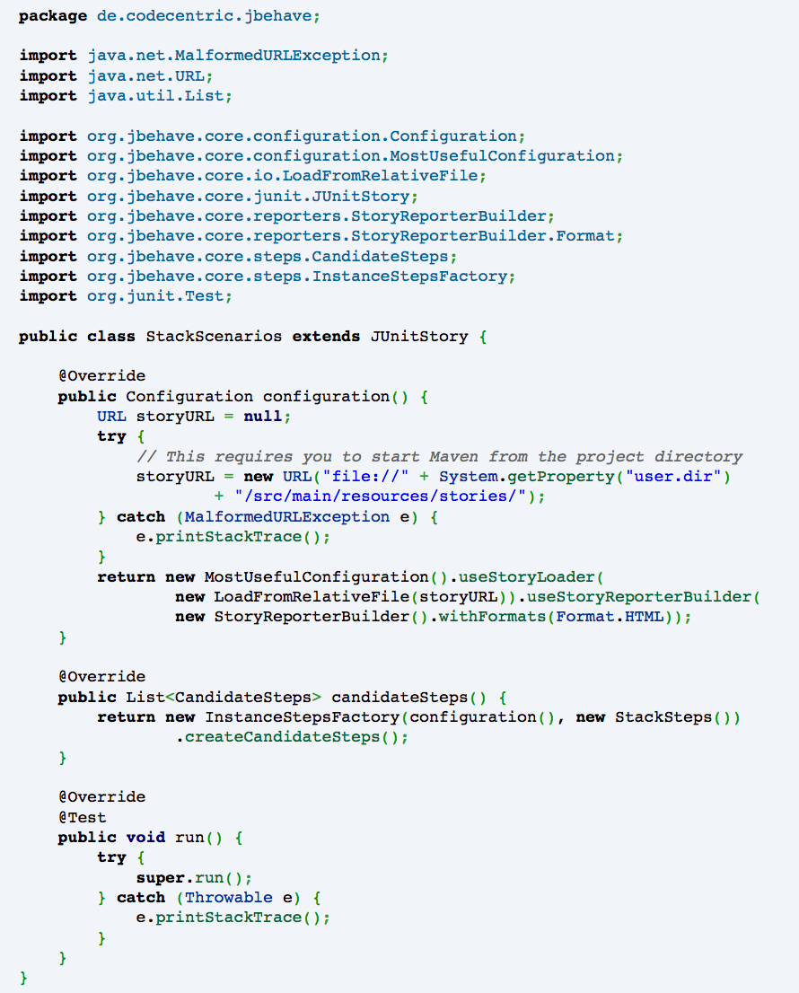

Slide 14
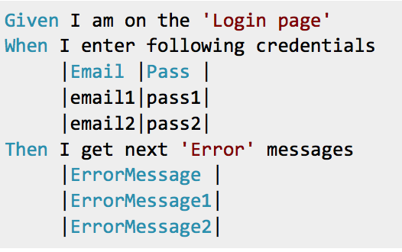
Data driven approach

Slide 15
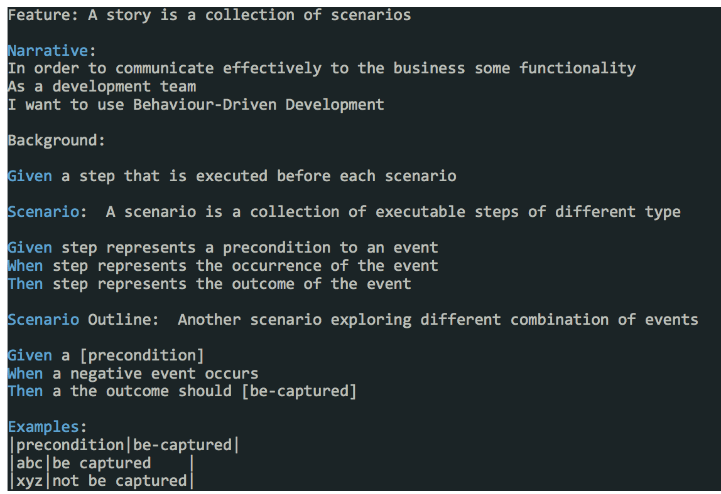

Slide 16
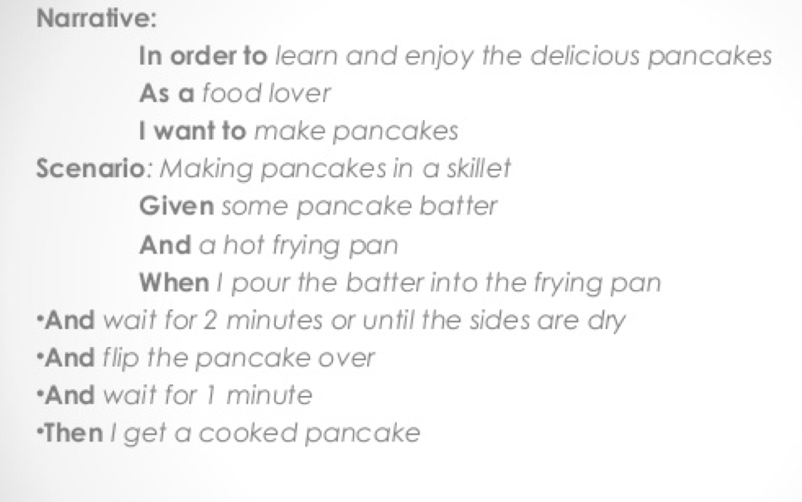
Pancakes

Slide 17
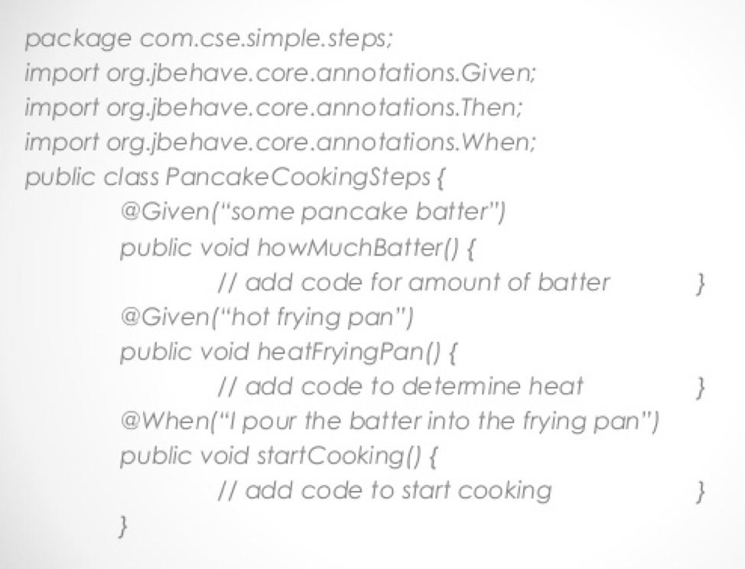
Java steps file -1

Slide 18
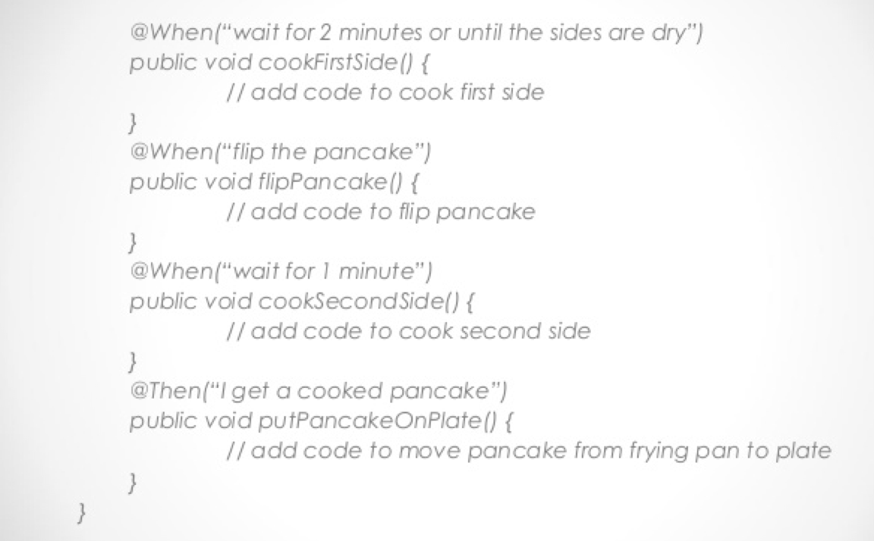
Java steps file -2

Slide 19
tutorial
https://blog.codecentric.de/en/2012/06/jbehave-configuration-tutorial/

